Slide 1
This Week Work Progress
Lecturer：SUSTech Li Yuchen
2019.3.28

Slide 2
content
01
Kaggle
02
Mis-Classification analysis
03
Studying machine learning & Tensorflow

Slide 3
Diabetic Retinopathy
Part One
01

Slide 4
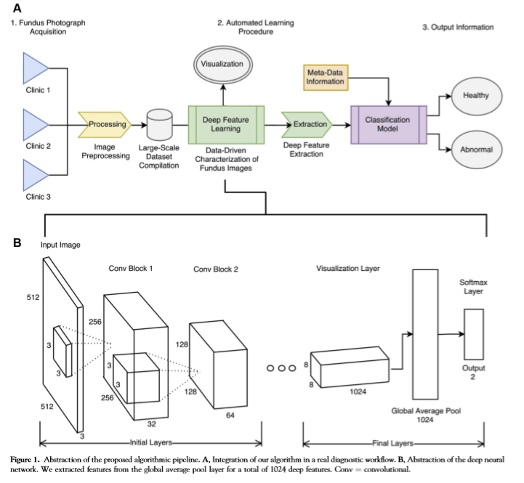
Automated Identification of Diabetic Retinopathy Using Deep Learning

Slide 5
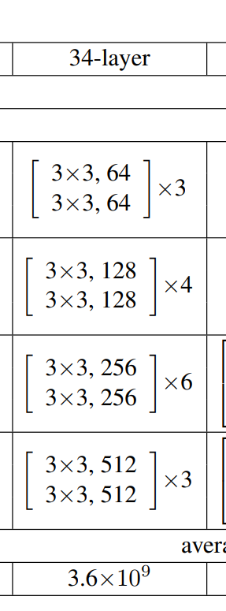
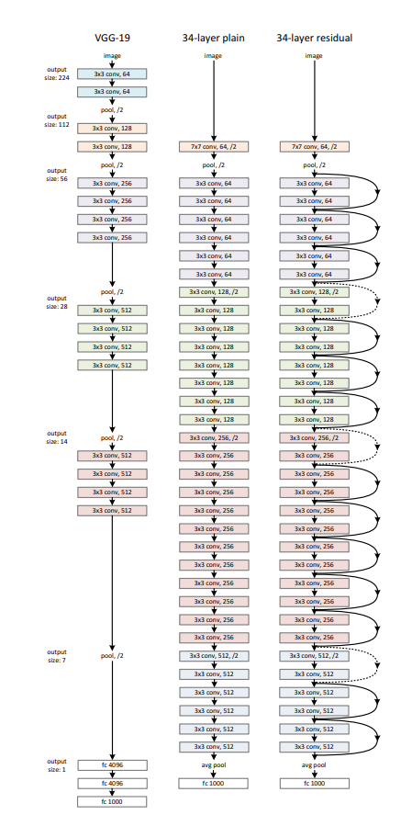
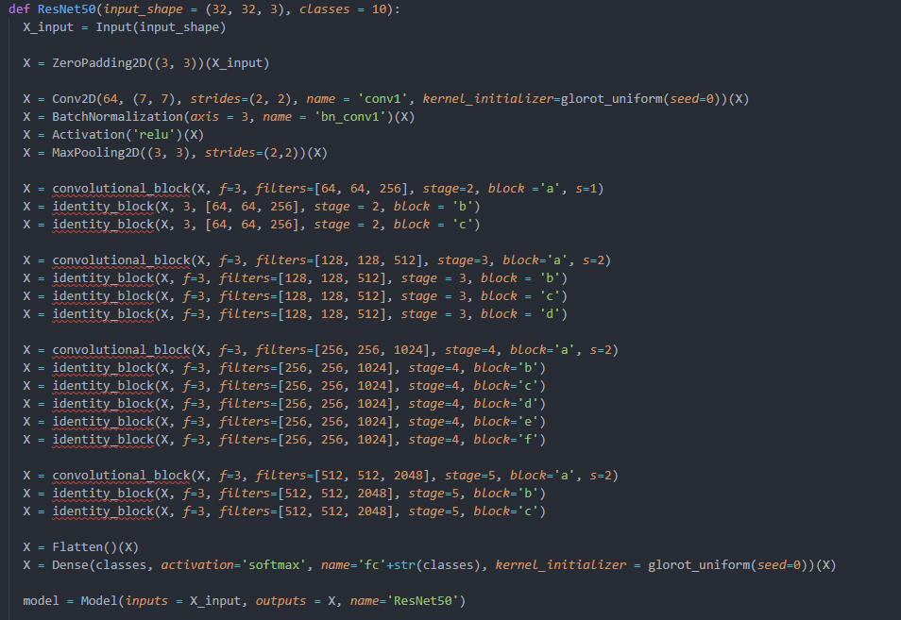
Deep Residual Learning for Image Recognition
Residual Blocks of convolutional layers
32 * 4
64 * 6
128 * 8
256 * 10
512 * 6

Slide 6
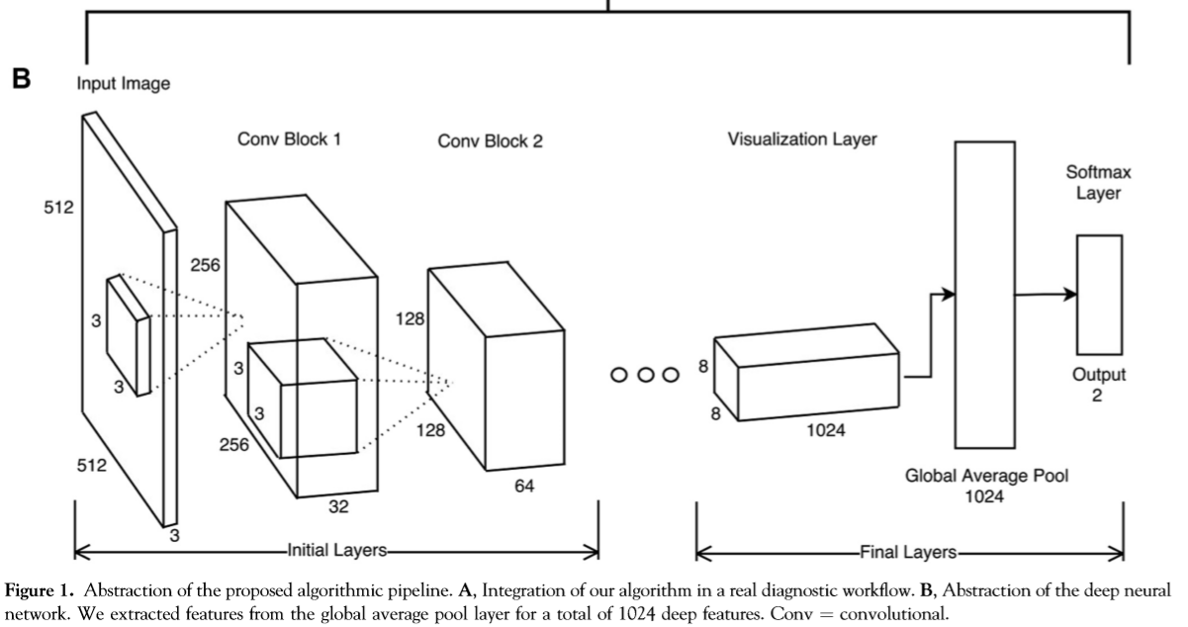
Deep Residual learning

Slide 7
Three Methods to Realize Resnet
Keras
Pre-trained models present in Keras (Using ImageNet’s Weights and Network Structure)
Re-training models present in keras (Using Resnet’s Structure but not weights)
Modify some structure in Resnet using keras
Final Test_Acc | Best Val_Acc
0.84375 | 0.8094

Slide 8
Image Quality Evaluation
Part Two
02

Slide 9
Study
Part Three
03

Slide 10
Future plan
01
Analyze the reasons & find questions
02
Try the methods
02
Study

Slide 11
THANKS
And Your Slogan Here.

